Slide 1
复杂度控制对语言模型推理能力的影响
许志钦
上海交通大学
2025年10月5日星期日

Slide 2

SLC24A5基因表达量与皮肤颜色
表达量高：浅色 表达量低：深色

Slide 3

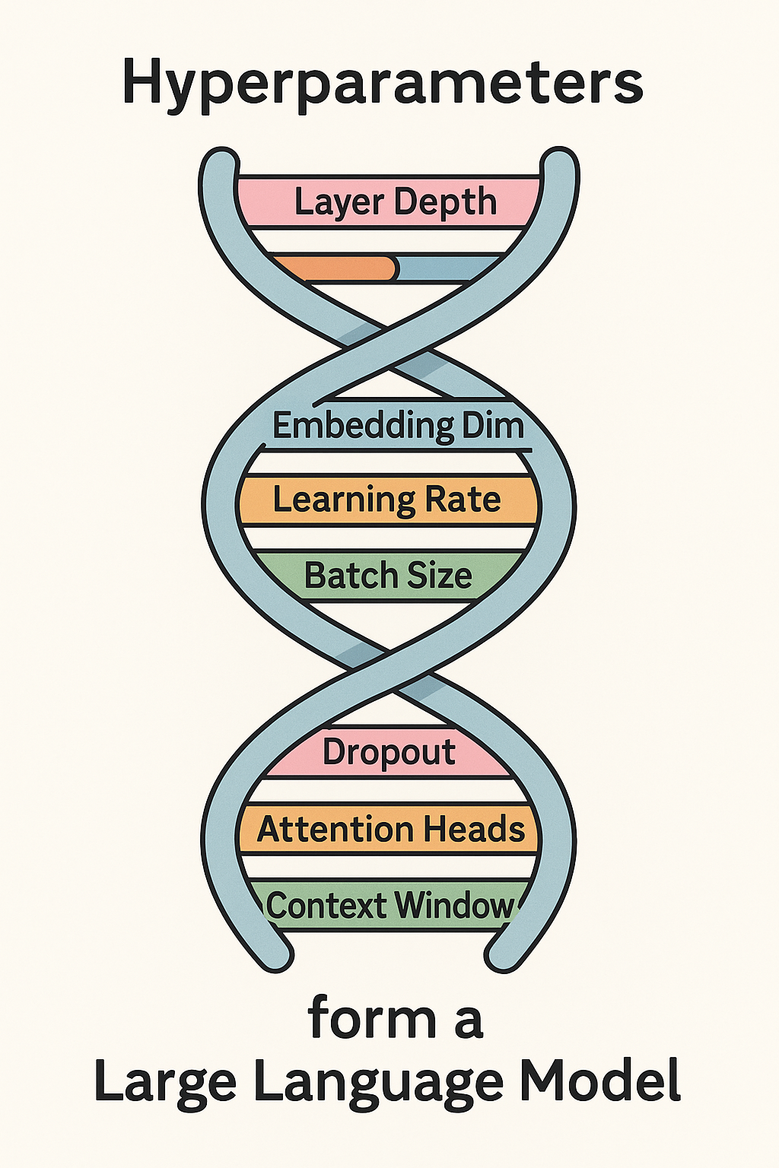


基因与超参数
Batch size → ?
Layer #→ ?
Initialization → ?
Opti meth → ?
.
.
SLC24A5 → 肤色
HERC2→ 眼颜色
LCT → 乳糖耐受性
ACTN3 → 运动能力
.
.

Slide 4
Memorization
Or
Reasoning?

Slide 5
What is Memorization & Reasoning?

Slide 6
What is Memorization & Reasoning?
Definition by examples.

Slide 7
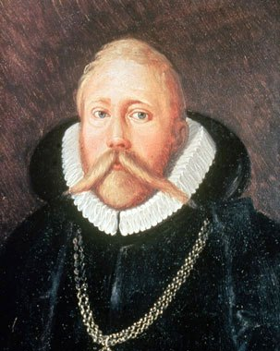
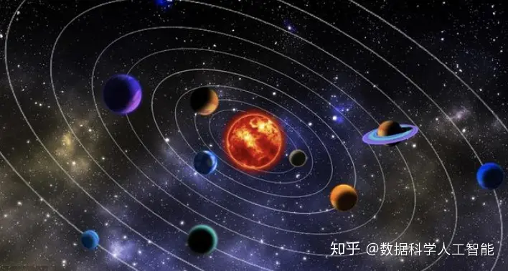
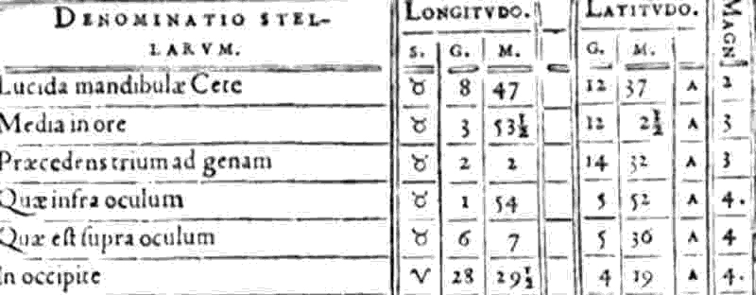
Memorization & Reasoning
Memorization
Star catalog manuscript
Tycho Brahe（1546-1601）

Slide 8
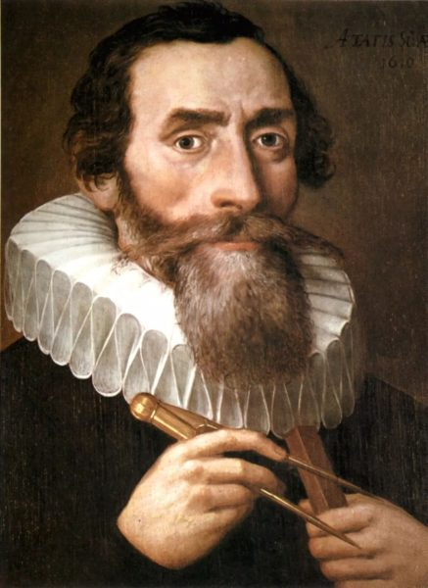
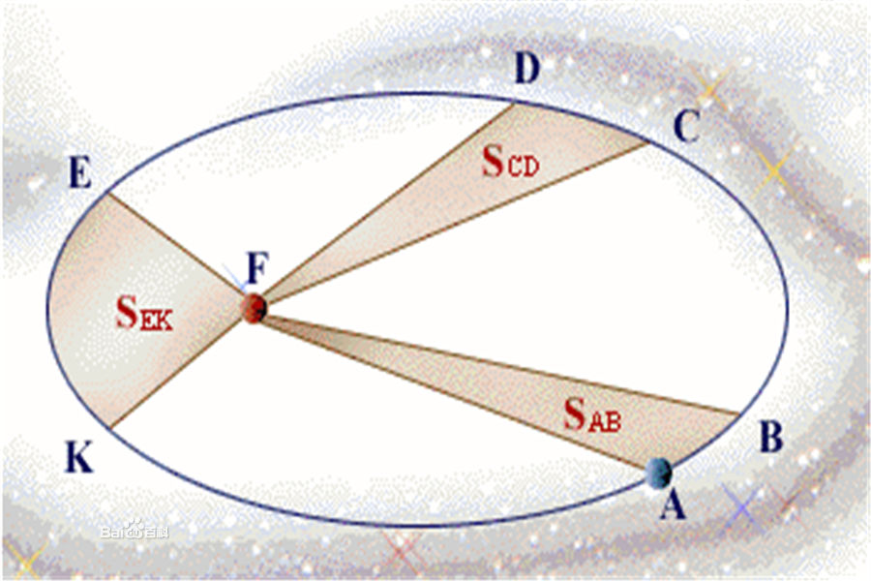
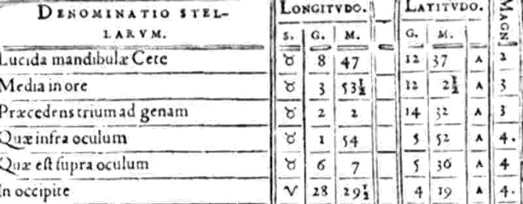
Memorization & Reasoning
Memorization
Reasoning
Kepler's Laws
Tycho Brahe（1546-1601）
Johannes Kepler （1572-1630）

Slide 9
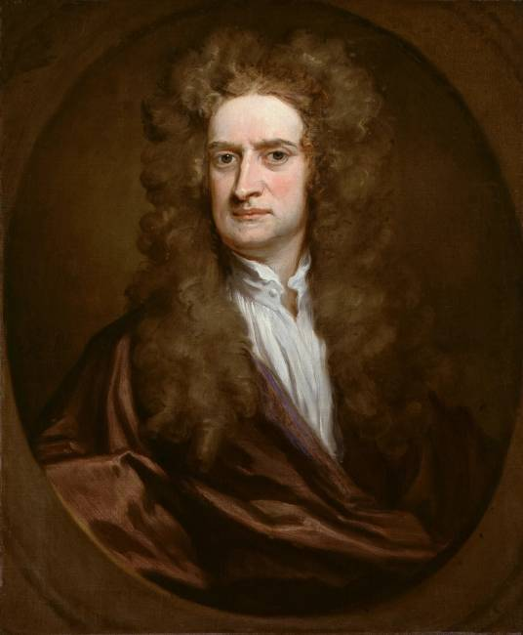
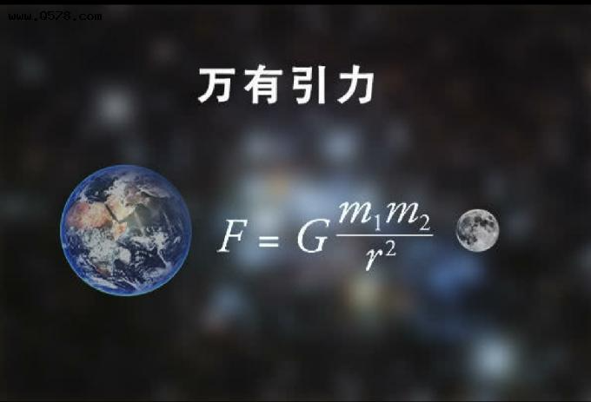
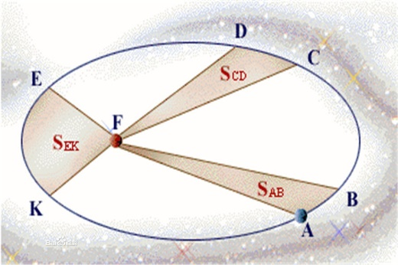

Memorization & Reasoning
Memorization
Reasoning
Reasoning+
F=ma
Tycho Brahe（1546-1601）
Johannes Kepler （1572-1630）
Isaac Newton
（1643-1727）

Slide 10
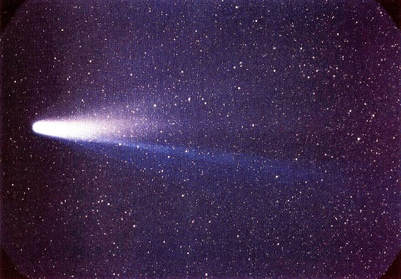
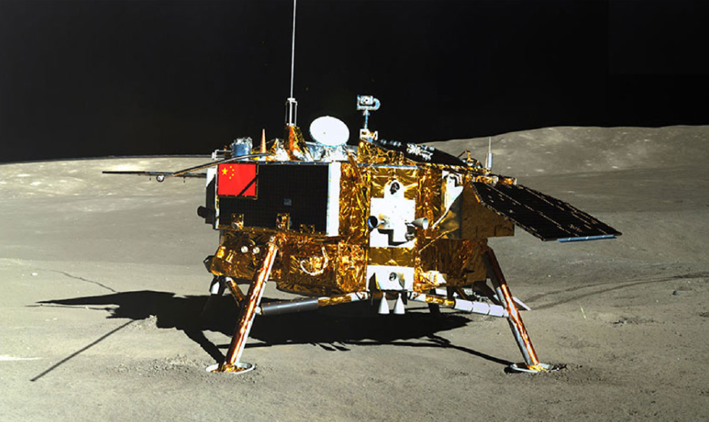

Memorization & Reasoning
Memorization
Reasoning
Reasoning+
哈雷彗星的发现
太空探测器的加速与轨道计算
Tycho Brahe（1546-1601）
Johannes Kepler （1572-1630）
Isaac Newton
（1643-1727）
具有广泛应用
F=ma
…

Slide 11
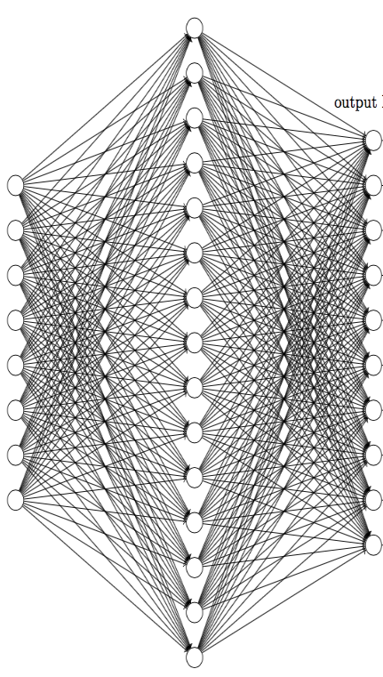


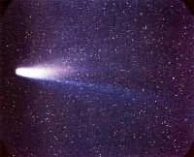
Memorization & Reasoning
NN
Memorization
No generalization
Train
To more planet data
Reasoning
F=ma
Widely used in many fields
Reasoning+

Slide 12
Difficulty in understanding
Complex
Complex
Data
Model
Can we study one by one?

Slide 13
Yes
Design a simple task to study NN.

Slide 14
Reasoning example
Try to remember these equations and do test, e.g.,（2，1，50）=？
(1, 2, 21) =27, (2, 1, 29) = 35 , (2, 1, 50) = 56, (1, 2, 31) = 37 , (1, 3, 16) = 19, (3, 1, 16) = 19
(1, 4, 67) = 64, (4, 1, 99) = 96 , (3, 2, 60) = 59, (2, 3, 50) = 49 , (4, 2, 48) = 41, (2 ,4, 38) = 31
(4, 3, 90) = 80, (3, 4, 77) = 67 , (1, 1, 51) = 61, (1, 1, 58) = 68 , (2, 2, 46) = 48, (2, 2, 35) = 37
(3, 3, 36) = 32, (3, 3, 29) = 25 , (4, 4, 46) = 30, (4, 4, 88) = 72 , (1, 3, 26) = 29, (3, 1, 36) = 39
(1, 2, 51) =57, (2, 1, 59) = 65 , (2, 1, 40) = 46, (1, 2, 51) = 57 , (1, 3, 36) = 39, (3, 1, 26) = 29
(1, 4, 17) = 14, (4, 1, 19) = 16 , (3, 2, 20) = 19, (2, 3, 30) = 29 , (4, 2, 18) = 11, (2 ,4, 78) = 71
(4, 3, 80) = 70, (3, 4, 57) = 47 , (1, 1, 71) = 81, (1, 1, 38) = 48 , (2, 2, 36) = 38, (2, 2, 25) = 27
(3, 3, 16) = 12, (3, 3, 69) = 65 , (4, 4, 26) = 10, (4, 4, 58) = 42
…
Zhongwang Zhang, Pengxiao Lin, Zhiwei Wang, Yaoyu Zhang, Zhi-Qin John Xu*, Initialization is Critical to Whether Transformers Fit Composite Functions by Reasoning or Memorizing, NeurIPS 2024

Slide 15
Reasoning example
Memorizing
(1, 2, 21) =27, (2, 1, 29) = 35
(2, 1, 50) = 56, (1, 2, 31) = 37
(1, 3, 16) = 19, (3, 1, 16) = 19
(1, 4, 67) = 64, (4, 1, 99) = 96
(3, 2, 60) = 59, (2, 3, 50) = 49
(4, 2, 48) = 41, (2 ,4, 38) = 31
(4, 3, 90) = 80, (3, 4, 77) = 67
(1, 1, 51) = 61, (1, 1, 58) = 68
(2, 2, 46) = 48, (2, 2, 35) = 37
(3, 3, 36) = 32, (3, 3, 29) = 25
(4, 4, 46) = 30, (4, 4, 88) = 72
…
Zhongwang Zhang, Pengxiao Lin, Zhiwei Wang, Yaoyu Zhang, Zhi-Qin John Xu*, Initialization is Critical to Whether Transformers Fit Composite Functions by Reasoning or Memorizing, NeurIPS 2024

Slide 16
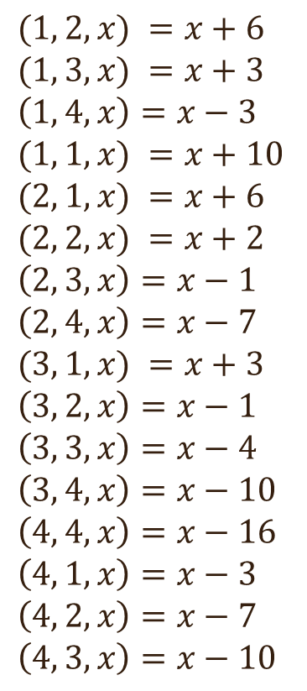
Reasoning example
Memorizing
Function relation
(1, 2, 21) =27, (2, 1, 29) = 35
(2, 1, 50) = 56, (1, 2, 31) = 37
(1, 3, 16) = 19, (3, 1, 16) = 19
(1, 4, 67) = 64, (4, 1, 99) = 96
(3, 2, 60) = 59, (2, 3, 50) = 49
(4, 2, 48) = 41, (2 ,4, 38) = 31
(4, 3, 90) = 80, (3, 4, 77) = 67
(1, 1, 51) = 61, (1, 1, 58) = 68
(2, 2, 46) = 48, (2, 2, 35) = 37
(3, 3, 36) = 32, (3, 3, 29) = 25
(4, 4, 46) = 30, (4, 4, 88) = 72
$(1, 2, x) =x+6$
$(1, 3, x) =x+3$
$\left(1, 4, x\right)=x−3$
$(1, 1, x) =x+10$
$(2, 1, x) =x+6$
$(2, 2, x) =x+2$
$\left(2, 3, x\right)=x−1$
$\left(2, 4, x\right)=x−7$
$(3, 1, x) =x+3$
$\left(3, 2, x\right)=x−1$
$\left(3, 3, x\right)=x−4$
$\left(3, 4, x\right)=x−10$
$\left(4, 4, x\right)=x−16$
$\left(4, 1, x\right)=x−3$
$\left(4, 2, x\right)=x−7$ $\left(4, 3, x\right)=x−10$
…
Zhongwang Zhang, Pengxiao Lin, Zhiwei Wang, Yaoyu Zhang, Zhi-Qin John Xu*, Initialization is Critical to Whether Transformers Fit Composite Functions by Reasoning or Memorizing, NeurIPS 2024

Slide 17
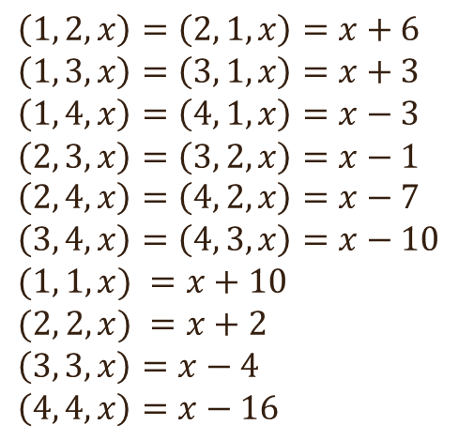
Reasoning example
Memorizing
Function relation
(1, 2, 21) =27, (2, 1, 29) = 35
(2, 1, 50) = 56, (1, 2, 31) = 37
(1, 3, 16) = 19, (3, 1, 16) = 19
(1, 4, 67) = 64, (4, 1, 99) = 96
(3, 2, 60) = 59, (2, 3, 50) = 49
(4, 2, 48) = 41, (2 ,4, 38) = 31
(4, 3, 90) = 80, (3, 4, 77) = 67
(1, 1, 51) = 61, (1, 1, 58) = 68
(2, 2, 46) = 48, (2, 2, 35) = 37
(3, 3, 36) = 32, (3, 3, 29) = 25
(4, 4, 46) = 30, (4, 4, 88) = 72
$(1, 2, x) =x+6$
$(1, 3, x) =x+3$
$\left(1, 4, x\right)=x−3$
$(1, 1, x) =x+10$
$(2, 1, x) =x+6$
$(2, 2, x) =x+2$
$\left(2, 3, x\right)=x−1$
$\left(2, 4, x\right)=x−7$
$(3, 1, x) =x+3$
$\left(3, 2, x\right)=x−1$
$\left(3, 3, x\right)=x−4$
$\left(3, 4, x\right)=x−10$
$\left(4, 4, x\right)=x−16$
$\left(4, 1, x\right)=x−3$
$\left(4, 2, x\right)=x−7$ $\left(4, 3, x\right)=x−10$
Symmetry
$\left(1, 2, x\right)=\left(2, 1, x\right)=x+6$
$\left(1, 3, x\right)=\left(3, 1, x\right)=x+3$
$\left(1, 4, x\right)=\left(4, 1, x\right)=x−3$ $\left(2, 3, x\right)=\left(3, 2, x\right)=x−1 \left(2, 4, x\right)=\left(4, 2, x\right)=x−7$
$$\left(3, 4, x\right)=\left(4, 3, x\right)=x−10$$
$(1, 1, x) =x+10$
$(2, 2, x) =x+2$
$\left(3, 3, x\right)=x−4$
$$\left(4, 4, x\right)=x−16$$
…
Zhongwang Zhang, Pengxiao Lin, Zhiwei Wang, Yaoyu Zhang, Zhi-Qin John Xu*, Initialization is Critical to Whether Transformers Fit Composite Functions by Reasoning or Memorizing, NeurIPS 2024

Slide 18

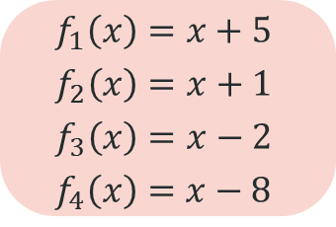
Reasoning example
How will LLM do?
Memory Complexity
Memorizing
Memorizing
Function relation
(1, 2, 21) =27, (2, 1, 29) = 35
(2, 1, 50) = 56, (1, 2, 31) = 37
(1, 3, 16) = 19, (3, 1, 16) = 19
(1, 4, 67) = 64, (4, 1, 99) = 96
(3, 2, 60) = 59, (2, 3, 50) = 49
(4, 2, 48) = 41, (2 ,4, 38) = 31
(4, 3, 90) = 80, (3, 4, 77) = 67
(1, 1, 51) = 61, (1, 1, 58) = 68
(2, 2, 46) = 48, (2, 2, 35) = 37
(3, 3, 36) = 32, (3, 3, 29) = 25
(4, 4, 46) = 30, (4, 4, 88) = 72
Reasoning Complexity
$(1, 2, x) =x+6$
$(1, 3, x) =x+3$
$\left(1, 4, x\right)=x−3$
$(1, 1, x) =x+10$
$(2, 1, x) =x+6$
$(2, 2, x) =x+2$
$\left(2, 3, x\right)=x−1$
$\left(2, 4, x\right)=x−7$
$(3, 1, x) =x+3$
$\left(3, 2, x\right)=x−1$
$\left(3, 3, x\right)=x−4$
$\left(3, 4, x\right)=x−10$
$\left(4, 4, x\right)=x−16$
$\left(4, 1, x\right)=x−3$
$\left(4, 2, x\right)=x−7$ $\left(4, 3, x\right)=x−10$
Symmetry
$\left(1, 2, x\right)=\left(2, 1, x\right)=x+6$
$\left(1, 3, x\right)=\left(3, 1, x\right)=x+3$
$\left(1, 4, x\right)=\left(4, 1, x\right)=x−3$ $\left(2, 3, x\right)=\left(3, 2, x\right)=x−1 \left(2, 4, x\right)=\left(4, 2, x\right)=x−7$
$$\left(3, 4, x\right)=\left(4, 3, x\right)=x−10$$
$(1, 1, x) =x+10$
$(2, 2, x) =x+2$
$\left(3, 3, x\right)=x−4$
$$\left(4, 4, x\right)=x−16$$
Composition
$$f_{1}\left(x\right)=x+5$$
$$f_{2}\left(x\right)=x+1$$
$$f_{3}\left(x\right)=x−2$$
$$f_{4}\left(x\right)=x−8$$
…
Zhongwang Zhang, Pengxiao Lin, Zhiwei Wang, Yaoyu Zhang, Zhi-Qin John Xu*, Initialization is Critical to Whether Transformers Fit Composite Functions by Reasoning or Memorizing, NeurIPS 2024

Slide 19
一个关键的超参数：$γ$

Slide 20
现在, 且把 $γ$ 当作是一个基因!

Slide 21
Reasoning example
大语言模型怎么做?
Memory Complexity
Memorizing
Memorizing
Function relation
(1, 2, 21) =27, (2, 1, 29) = 35
(2, 1, 50) = 56, (1, 2, 31) = 37
(1, 3, 16) = 19, (3, 1, 16) = 19
(1, 4, 67) = 64, (4, 1, 99) = 96
(3, 2, 60) = 59, (2, 3, 50) = 49
(4, 2, 48) = 41, (2 ,4, 38) = 31
(4, 3, 90) = 80, (3, 4, 77) = 67
(1, 1, 51) = 61, (1, 1, 58) = 68
(2, 2, 46) = 48, (2, 2, 35) = 37
(3, 3, 36) = 32, (3, 3, 29) = 25
(4, 4, 46) = 30, (4, 4, 88) = 72
Reasoning Complexity
$(1, 2, x) =x+6$
$(1, 3, x) =x+3$
$\left(1, 4, x\right)=x−3$
$(1, 1, x) =x+10$
$(2, 1, x) =x+6$
$(2, 2, x) =x+2$
$\left(2, 3, x\right)=x−1$
$\left(2, 4, x\right)=x−7$
$(3, 1, x) =x+3$
$\left(3, 2, x\right)=x−1$
$\left(3, 3, x\right)=x−4$
$\left(3, 4, x\right)=x−10$
$\left(4, 4, x\right)=x−16$
$\left(4, 1, x\right)=x−3$
$\left(4, 2, x\right)=x−7$ $\left(4, 3, x\right)=x−10$
Symmetry
$\left(1, 2, x\right)=\left(2, 1, x\right)=x+6$
$\left(1, 3, x\right)=\left(3, 1, x\right)=x+3$
$\left(1, 4, x\right)=\left(4, 1, x\right)=x−3$ $\left(2, 3, x\right)=\left(3, 2, x\right)=x−1 \left(2, 4, x\right)=\left(4, 2, x\right)=x−7$
$$\left(3, 4, x\right)=\left(4, 3, x\right)=x−10$$
$(1, 1, x) =x+10$
$(2, 2, x) =x+2$
$\left(3, 3, x\right)=x−4$
$$\left(4, 4, x\right)=x−16$$
Composition
$$f_{1}\left(x\right)=x+5$$
$$f_{2}\left(x\right)=x+1$$
$$f_{3}\left(x\right)=x−2$$
$$f_{4}\left(x\right)=x−8$$
…
Zhongwang Zhang, Pengxiao Lin, Zhiwei Wang, Yaoyu Zhang, Zhi-Qin John Xu*, Initialization is Critical to Whether Transformers Fit Composite Functions by Reasoning or Memorizing, NeurIPS 2024

Slide 22

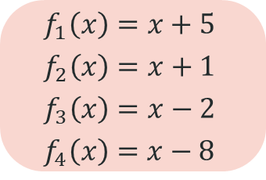
推理与记忆的例子
大语言模型怎么做?
Memorizing
Function relation
(1, 2, 21) =27, (2, 1, 29) = 35
(2, 1, 50) = 56, (1, 2, 31) = 37
(1, 3, 16) = 19, (3, 1, 16) = 19
(1, 4, 67) = 64, (4, 1, 99) = 96
(3, 2, 60) = 59, (2, 3, 50) = 49
(4, 2, 48) = 41, (2 ,4, 38) = 31
(4, 3, 90) = 80, (3, 4, 77) = 67
(1, 1, 51) = 61, (1, 1, 58) = 68
(2, 2, 46) = 48, (2, 2, 35) = 37
(3, 3, 36) = 32, (3, 3, 29) = 25
(4, 4, 46) = 30, (4, 4, 88) = 72
$(1, 2, x) =x+6$
$(1, 3, x) =x+3$
$\left(1, 4, x\right)=x−3$
$(1, 1, x) =x+10$
$(2, 1, x) =x+6$
$(2, 2, x) =x+2$
$\left(2, 3, x\right)=x−1$
$\left(2, 4, x\right)=x−7$
$(3, 1, x) =x+3$
$\left(3, 2, x\right)=x−1$
$\left(3, 3, x\right)=x−4$
$\left(3, 4, x\right)=x−10$
$\left(4, 4, x\right)=x−16$
$\left(4, 1, x\right)=x−3$
$\left(4, 2, x\right)=x−7$ $\left(4, 3, x\right)=x−10$
Symmetry
$\left(1, 2, x\right)=\left(2, 1, x\right)=x+6$
$\left(1, 3, x\right)=\left(3, 1, x\right)=x+3$
$\left(1, 4, x\right)=\left(4, 1, x\right)=x−3$ $\left(2, 3, x\right)=\left(3, 2, x\right)=x−1 \left(2, 4, x\right)=\left(4, 2, x\right)=x−7$
$$\left(3, 4, x\right)=\left(4, 3, x\right)=x−10$$
$(1, 1, x) =x+10$
$(2, 2, x) =x+2$
$\left(3, 3, x\right)=x−4$
$$\left(4, 4, x\right)=x−16$$
Composition
$$f_{1}\left(x\right)=x+5$$
$$f_{2}\left(x\right)=x+1$$
$$f_{3}\left(x\right)=x−2$$
$$f_{4}\left(x\right)=x−8$$
$γ$ 很小
Zhongwang Zhang, Pengxiao Lin, Zhiwei Wang, Yaoyu Zhang, Zhi-Qin John Xu*, Initialization is Critical to Whether Transformers Fit Composite Functions by Inference or Memorizing, NeurIPS 2024

Slide 23

推理与记忆的例子
大语言模型怎么做?
Memorizing
Function relation
(1, 2, 21) =27, (2, 1, 29) = 35
(2, 1, 50) = 56, (1, 2, 31) = 37
(1, 3, 16) = 19, (3, 1, 16) = 19
(1, 4, 67) = 64, (4, 1, 99) = 96
(3, 2, 60) = 59, (2, 3, 50) = 49
(4, 2, 48) = 41, (2 ,4, 38) = 31
(4, 3, 90) = 80, (3, 4, 77) = 67
(1, 1, 51) = 61, (1, 1, 58) = 68
(2, 2, 46) = 48, (2, 2, 35) = 37
(3, 3, 36) = 32, (3, 3, 29) = 25
(4, 4, 46) = 30, (4, 4, 88) = 72
$(1, 2, x) =x+6$
$(1, 3, x) =x+3$
$\left(1, 4, x\right)=x−3$
$(1, 1, x) =x+10$
$(2, 1, x) =x+6$
$(2, 2, x) =x+2$
$\left(2, 3, x\right)=x−1$
$\left(2, 4, x\right)=x−7$
$(3, 1, x) =x+3$
$\left(3, 2, x\right)=x−1$
$\left(3, 3, x\right)=x−4$
$\left(3, 4, x\right)=x−10$
$\left(4, 4, x\right)=x−16$
$\left(4, 1, x\right)=x−3$
$\left(4, 2, x\right)=x−7$ $\left(4, 3, x\right)=x−10$
Symmetry
$\left(1, 2, x\right)=\left(2, 1, x\right)=x+6$
$\left(1, 3, x\right)=\left(3, 1, x\right)=x+3$
$\left(1, 4, x\right)=\left(4, 1, x\right)=x−3$ $\left(2, 3, x\right)=\left(3, 2, x\right)=x−1 \left(2, 4, x\right)=\left(4, 2, x\right)=x−7$
$$\left(3, 4, x\right)=\left(4, 3, x\right)=x−10$$
$(1, 1, x) =x+10$
$(2, 2, x) =x+2$
$\left(3, 3, x\right)=x−4$
$$\left(4, 4, x\right)=x−16$$
Composition
$$f_{1}\left(x\right)=x+5$$
$$f_{2}\left(x\right)=x+1$$
$$f_{3}\left(x\right)=x−2$$
$$f_{4}\left(x\right)=x−8$$
$γ$ 增大
Zhongwang Zhang, Pengxiao Lin, Zhiwei Wang, Yaoyu Zhang, Zhi-Qin John Xu*, Initialization is Critical to Whether Transformers Fit Composite Functions by Inference or Memorizing, NeurIPS 2024

Slide 24

推理与记忆的例子
大语言模型怎么做?
Memorizing
Function relation
(1, 2, 21) =27, (2, 1, 29) = 35
(2, 1, 50) = 56, (1, 2, 31) = 37
(1, 3, 16) = 19, (3, 1, 16) = 19
(1, 4, 67) = 64, (4, 1, 99) = 96
(3, 2, 60) = 59, (2, 3, 50) = 49
(4, 2, 48) = 41, (2 ,4, 38) = 31
(4, 3, 90) = 80, (3, 4, 77) = 67
(1, 1, 51) = 61, (1, 1, 58) = 68
(2, 2, 46) = 48, (2, 2, 35) = 37
(3, 3, 36) = 32, (3, 3, 29) = 25
(4, 4, 46) = 30, (4, 4, 88) = 72
$(1, 2, x) =x+6$
$(1, 3, x) =x+3$
$\left(1, 4, x\right)=x−3$
$(1, 1, x) =x+10$
$(2, 1, x) =x+6$
$(2, 2, x) =x+2$
$\left(2, 3, x\right)=x−1$
$\left(2, 4, x\right)=x−7$
$(3, 1, x) =x+3$
$\left(3, 2, x\right)=x−1$
$\left(3, 3, x\right)=x−4$
$\left(3, 4, x\right)=x−10$
$\left(4, 4, x\right)=x−16$
$\left(4, 1, x\right)=x−3$
$\left(4, 2, x\right)=x−7$ $\left(4, 3, x\right)=x−10$
Symmetry
$\left(1, 2, x\right)=\left(2, 1, x\right)=x+6$
$\left(1, 3, x\right)=\left(3, 1, x\right)=x+3$
$\left(1, 4, x\right)=\left(4, 1, x\right)=x−3$ $\left(2, 3, x\right)=\left(3, 2, x\right)=x−1 \left(2, 4, x\right)=\left(4, 2, x\right)=x−7$
$$\left(3, 4, x\right)=\left(4, 3, x\right)=x−10$$
$(1, 1, x) =x+10$
$(2, 2, x) =x+2$
$\left(3, 3, x\right)=x−4$
$$\left(4, 4, x\right)=x−16$$
Composition
$$f_{1}\left(x\right)=x+5$$
$$f_{2}\left(x\right)=x+1$$
$$f_{3}\left(x\right)=x−2$$
$$f_{4}\left(x\right)=x−8$$
$γ$ 较大
Zhongwang Zhang, Pengxiao Lin, Zhiwei Wang, Yaoyu Zhang, Zhi-Qin John Xu*, Initialization is Critical to Whether Transformers Fit Composite Functions by Inference or Memorizing, NeurIPS 2024

Slide 25
推理与记忆的例子
大语言模型怎么做?
Memorizing
Function relation
(1, 2, 21) =27, (2, 1, 29) = 35
(2, 1, 50) = 56, (1, 2, 31) = 37
(1, 3, 16) = 19, (3, 1, 16) = 19
(1, 4, 67) = 64, (4, 1, 99) = 96
(3, 2, 60) = 59, (2, 3, 50) = 49
(4, 2, 48) = 41, (2 ,4, 38) = 31
(4, 3, 90) = 80, (3, 4, 77) = 67
(1, 1, 51) = 61, (1, 1, 58) = 68
(2, 2, 46) = 48, (2, 2, 35) = 37
(3, 3, 36) = 32, (3, 3, 29) = 25
(4, 4, 46) = 30, (4, 4, 88) = 72
$(1, 2, x) =x+6$
$(1, 3, x) =x+3$
$\left(1, 4, x\right)=x−3$
$(1, 1, x) =x+10$
$(2, 1, x) =x+6$
$(2, 2, x) =x+2$
$\left(2, 3, x\right)=x−1$
$\left(2, 4, x\right)=x−7$
$(3, 1, x) =x+3$
$\left(3, 2, x\right)=x−1$
$\left(3, 3, x\right)=x−4$
$\left(3, 4, x\right)=x−10$
$\left(4, 4, x\right)=x−16$
$\left(4, 1, x\right)=x−3$
$\left(4, 2, x\right)=x−7$ $\left(4, 3, x\right)=x−10$
Symmetry
$\left(1, 2, x\right)=\left(2, 1, x\right)=x+6$
$\left(1, 3, x\right)=\left(3, 1, x\right)=x+3$
$\left(1, 4, x\right)=\left(4, 1, x\right)=x−3$ $\left(2, 3, x\right)=\left(3, 2, x\right)=x−1 \left(2, 4, x\right)=\left(4, 2, x\right)=x−7$
$$\left(3, 4, x\right)=\left(4, 3, x\right)=x−10$$
$(1, 1, x) =x+10$
$(2, 2, x) =x+2$
$\left(3, 3, x\right)=x−4$
$$\left(4, 4, x\right)=x−16$$
Composition
$$f_{1}\left(x\right)=x+5$$
$$f_{2}\left(x\right)=x+1$$
$$f_{3}\left(x\right)=x−2$$
$$f_{4}\left(x\right)=x−8$$
$γ$ 很大
Zhongwang Zhang, Pengxiao Lin, Zhiwei Wang, Yaoyu Zhang, Zhi-Qin John Xu*, Initialization is Critical to Whether Transformers Fit Composite Functions by Inference or Memorizing, NeurIPS 2024

Slide 26
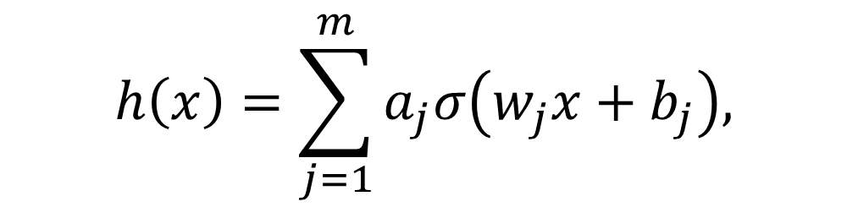
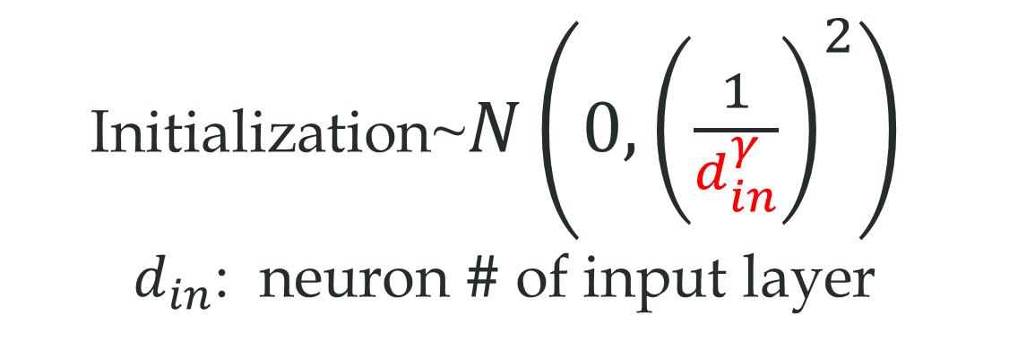
Key hyper-parameter
$$h\left(x\right)=\sum_{j=1}^{m}{a_{j}σ\left(w_{j}x+b_{j}\right),}$$
Initialization~$N\left(0,{\left(\frac{1}{d_{in}^{γ}}\right)}^{2}\right)$
$d_{in}$: neuron # of input layer
Zhongwang Zhang, Pengxiao Lin, Zhiwei Wang, Yaoyu Zhang, Zhi-Qin John Xu*, Initialization is Critical to Whether Transformers Fit Composite Functions by Reasoning or Memorizing, NeurIPS 2024

Slide 27
Anchor function
Designated Token as Anchor
Other Token as Key
Data set
(21, 1, 2, 27)
(29, 2, 1, 35)
(50, 2, 1, 56)
(29, 3, 3, 25)
(46, 4, 4, 30)
1
:
+5
5
Train model to predict Targets
2
:
+1
6
3
:
-2
…
…
4
:
-8
100
Key
Anchor
Target

Slide 28
NN to learn Anchor function
Loss only here
Calculate loss
Data set
NN
Output
Target
(21, 1, 2, 27)
(29, 2, 1, 35)
(50, 2, 1, 56)
(29, 3, 3, 25)
(46, 4, 4, 30)
. . .
…
5
1
2
Key
Anchor
Target
Other Token as Key
Designated Token as Anchor

Slide 29
Generalization for Anchor function
Loss only here
Calculate loss
Data generalization
Task generalization
Output
Target
This comb is not seen during training
NN
. . .
(21, 1, 2)
(21, 4, 3)
Anchor pair is seen
Anchor pair NOT seen
5
1
2
Anchor pair (4,3) and (3,4) NOT seen
Other Token as Key
Designated Token as Anchor

Slide 30
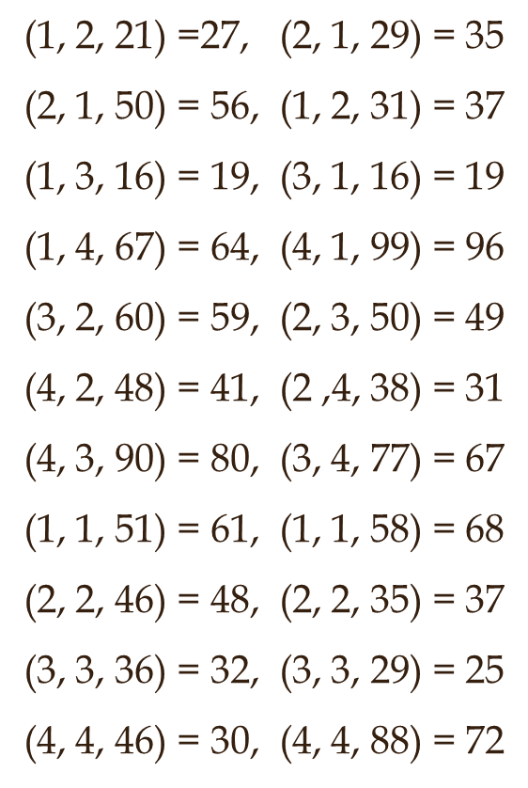
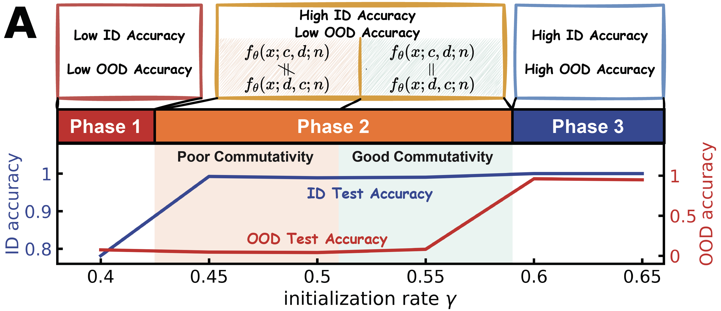
训练中不出现34和43两个函数
记忆
训练集精度：100%
ID: Seen anchors; OOD: unseen anchors
记忆
…
Zhongwang Zhang, Pengxiao Lin, Zhiwei Wang, Yaoyu Zhang, Zhi-Qin John Xu*, Complexity Control Facilitates Reasoning-Based Compositional Generalization in Transformers, arxiv 2501.08537

Slide 31
训练中不出现34和43两个函数
函数关系
训练集精度：100%
ID: Seen anchors; OOD: unseen anchors
记忆
方程关系
Zhongwang Zhang, Pengxiao Lin, Zhiwei Wang, Yaoyu Zhang, Zhi-Qin John Xu*, Complexity Control Facilitates Reasoning-Based Compositional Generalization in Transformers, arxiv 2501.08537

Slide 32
训练中不出现34和43两个函数
对称性
训练集精度：100%
ID: Seen anchors; OOD: unseen anchors
记忆
方程关系
对称性
Zhongwang Zhang, Pengxiao Lin, Zhiwei Wang, Yaoyu Zhang, Zhi-Qin John Xu*, Complexity Control Facilitates Reasoning-Based Compositional Generalization in Transformers, arxiv 2501.08537

Slide 33
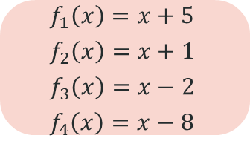
训练中不出现34和43两个函数
训练集精度：100%
ID: Seen anchors; OOD: unseen anchors
记忆
方程关系
对称性
复合性
Composition
$$f_{1}\left(x\right)=x+5$$
$$f_{2}\left(x\right)=x+1$$
$$f_{3}\left(x\right)=x−2$$
$$f_{4}\left(x\right)=x−8$$
Zhongwang Zhang, Pengxiao Lin, Zhiwei Wang, Yaoyu Zhang, Zhi-Qin John Xu*, Complexity Control Facilitates Reasoning-Based Compositional Generalization in Transformers, arxiv 2501.08537

Slide 34
Key hyper-parameter
$$h\left(x\right)=\sum_{j=1}^{m}{a_{j}σ\left(w_{j}x+b_{j}\right),}$$
Initialization~$N\left(0,{\left(\frac{1}{d_{in}^{γ}}\right)}^{2}\right)$
$d_{in}$: neuron # of input layer
Zhongwang Zhang, Pengxiao Lin, Zhiwei Wang, Yaoyu Zhang, Zhi-Qin John Xu*, Initialization is Critical to Whether Transformers Fit Composite Functions by Reasoning or Memorizing, NeurIPS 2024

Slide 35
大模型初始化相图
复合映射整体的性质变化
是否学到单映射
记忆
方程关系
对称性
复合性
大初始化
小初始化
Zhongwang Zhang, Pengxiao Lin, Zhiwei Wang, Yaoyu Zhang, Zhi-Qin John Xu*, Complexity Control Facilitates Reasoning-Based Compositional Generalization in Transformers, arxiv 2501.08537

Slide 36
Does the net learn each anchor mapping?
Zhongwang Zhang, Pengxiao Lin, Zhiwei Wang, Yaoyu Zhang, Zhi-Qin John Xu*, Initialization is Critical to Whether Transformers Fit Composite Functions by Inference or Memorizing, NeurIPS 2024

Slide 37
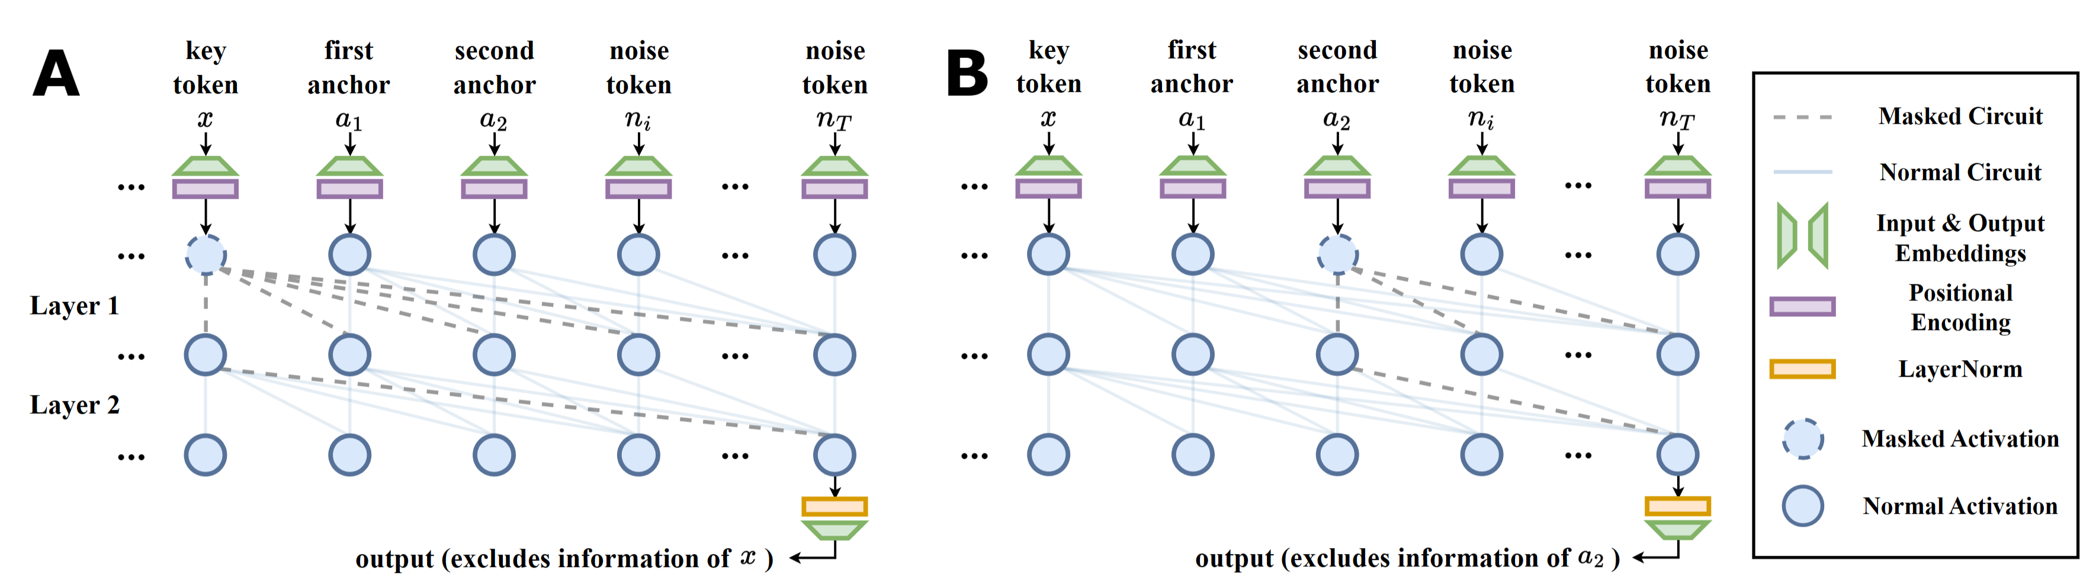
信息遮蔽
复合映射性质变化?
单映射是否学到?
遮蔽 key token
遮蔽第二个anchor

Slide 38
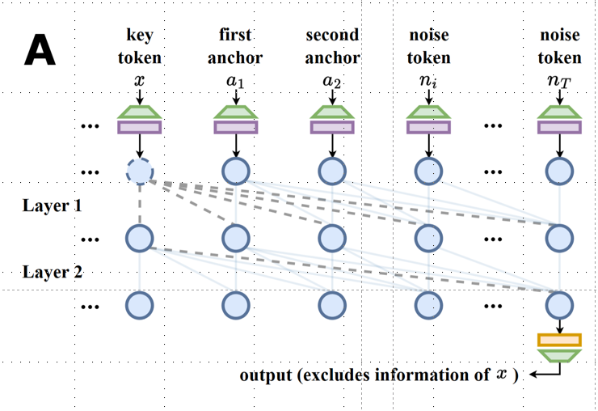
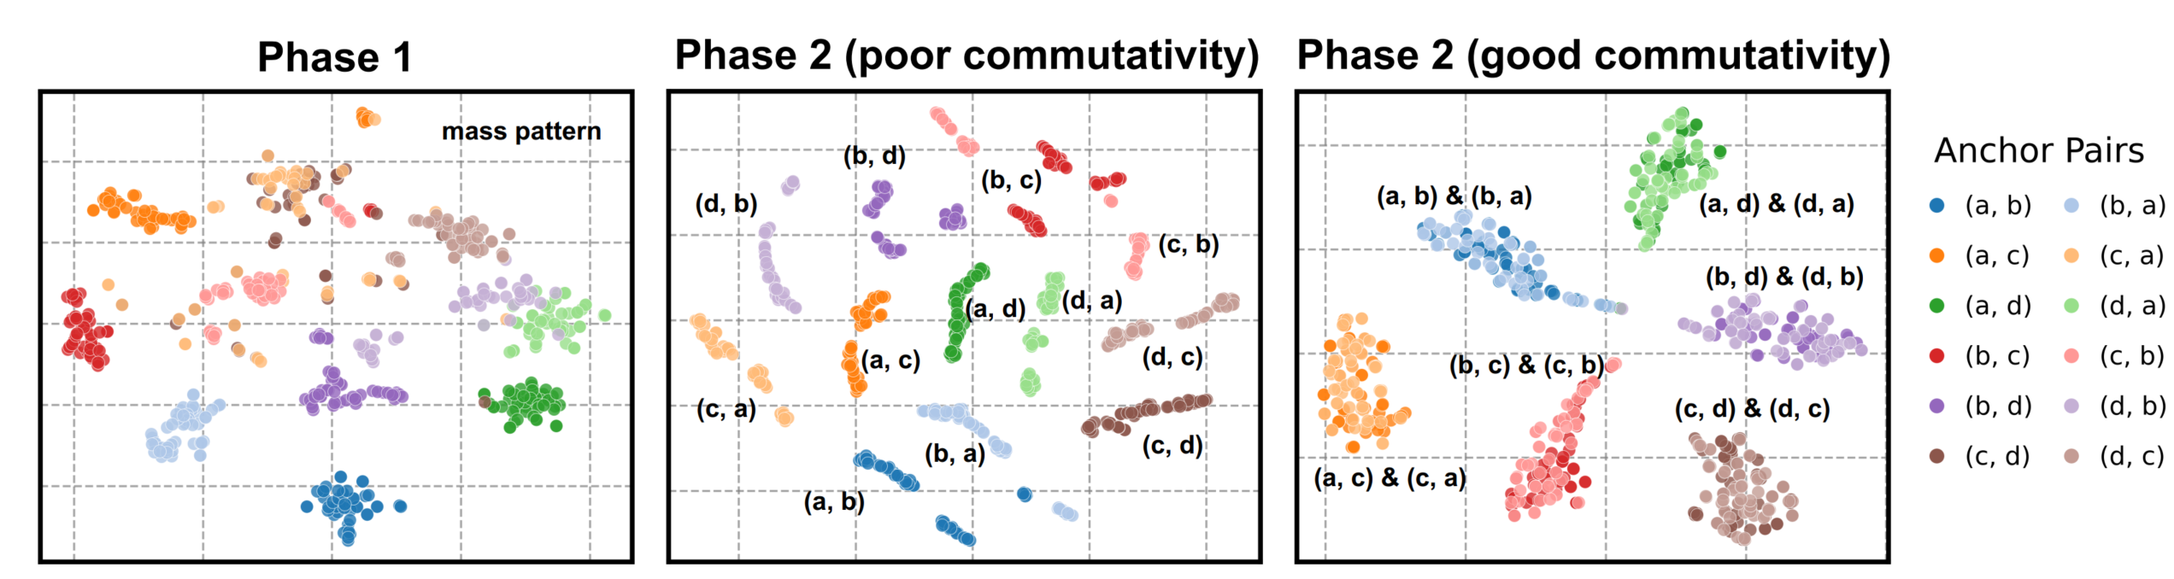
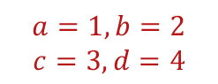
复合映射性质变化
不同锚点对输入数据所对应的输出的 TSNE图
记忆
方程关系
对称性
$$a=1,b=2$$
$$c=3,d=4$$

Slide 39
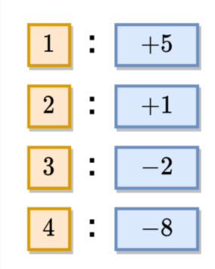
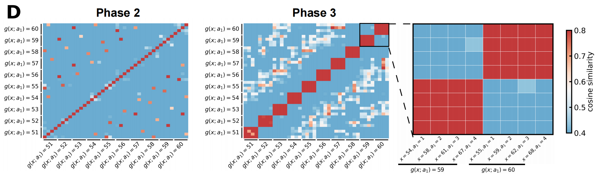
单映射是否学到
不同关键项-锚点组合的输入数据所对应的输出的余弦相似度

Slide 40
Why initialization matters?
Zhongwang Zhang, Pengxiao Lin, Zhiwei Wang, Yaoyu Zhang, Zhi-Qin John Xu*, Initialization is Critical to Whether Transformers Fit Composite Functions by Reasoning or Memorizing, NeurIPS 2024

Slide 41
Key phenomenon: Condensation!
Zhongwang Zhang, Pengxiao Lin, Zhiwei Wang, Yaoyu Zhang, Zhi-Qin John Xu*, Initialization is Critical to Whether Transformers Fit Composite Functions by Reasoning or Memorizing, NeurIPS 2024

Slide 42
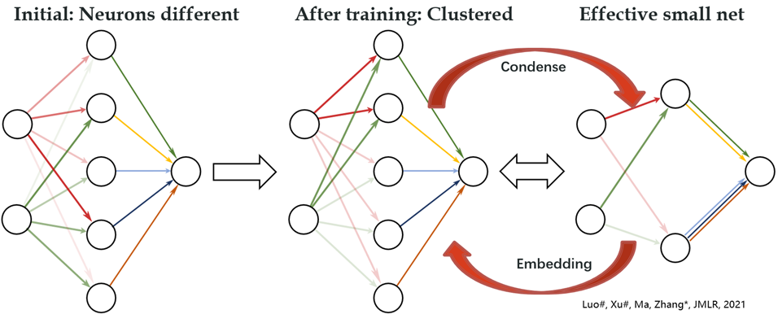

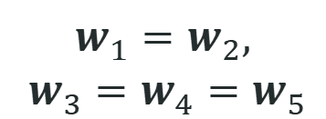
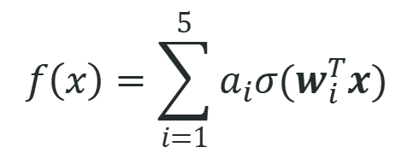
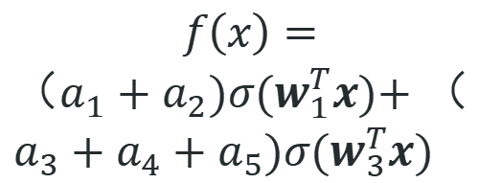
Condensation with small initialization
$$f\left(x\right)=\sum_{i=1}^{5}{a_{i}σ(w_{i}^{T}x)}$$
$$f\left(x\right)=$$
$（a_{1}+a_{2})σ(w_{1}^{T}x)\text{+}$ $（a_{3}+a_{4}+a_{5})σ(w_{3}^{T}x)$
$$w_{1}^{ }=w_{2}^{ },$$
$${ w}_{3}^{ }=w_{4}^{ }=w_{5}^{ }$$
Initial：random
After training：
Condense
Effective：
Small net
Luo#, Xu#, Ma, Zhang*, 2007.07497, JMLR; Zhou, Zhou, Jin Luo, Zhang*, Xu*, NeurIPS 2022

Slide 43
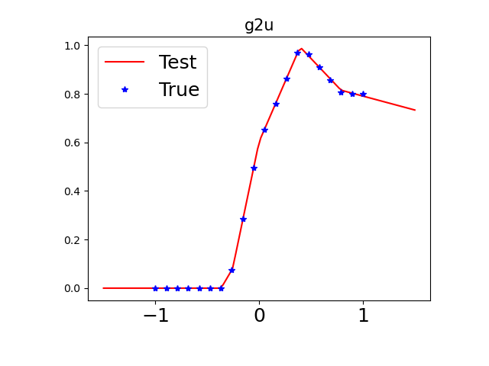
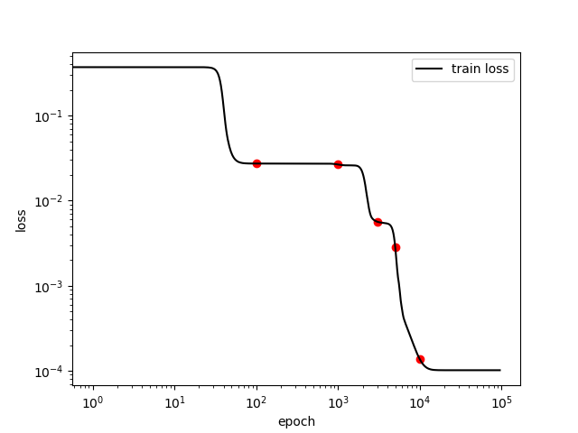
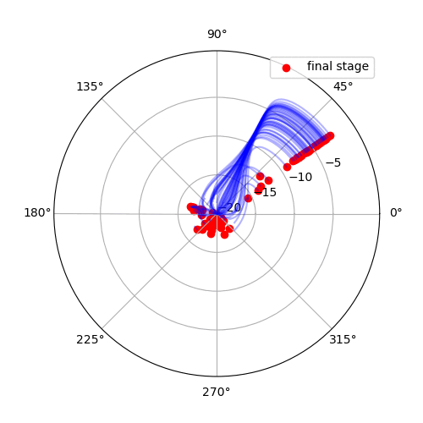




1d example: condensation with small initialization
$$f_{θ}\left(x\right)=\sum_{j=1}^{m}{a_{j}σ{(w_{j}x+b_{j})}}$$
Each point: ($w_{j},b_{j}$)
$$b$$
$$w$$
Tao Luo#, Zhi-Qin John Xu #, Zheng Ma, Yaoyu Zhang*,
Phase diagram for two-layer ReLU neural networks at infinite-width limit, Journal of Machine Learning Research (2021)

Slide 44
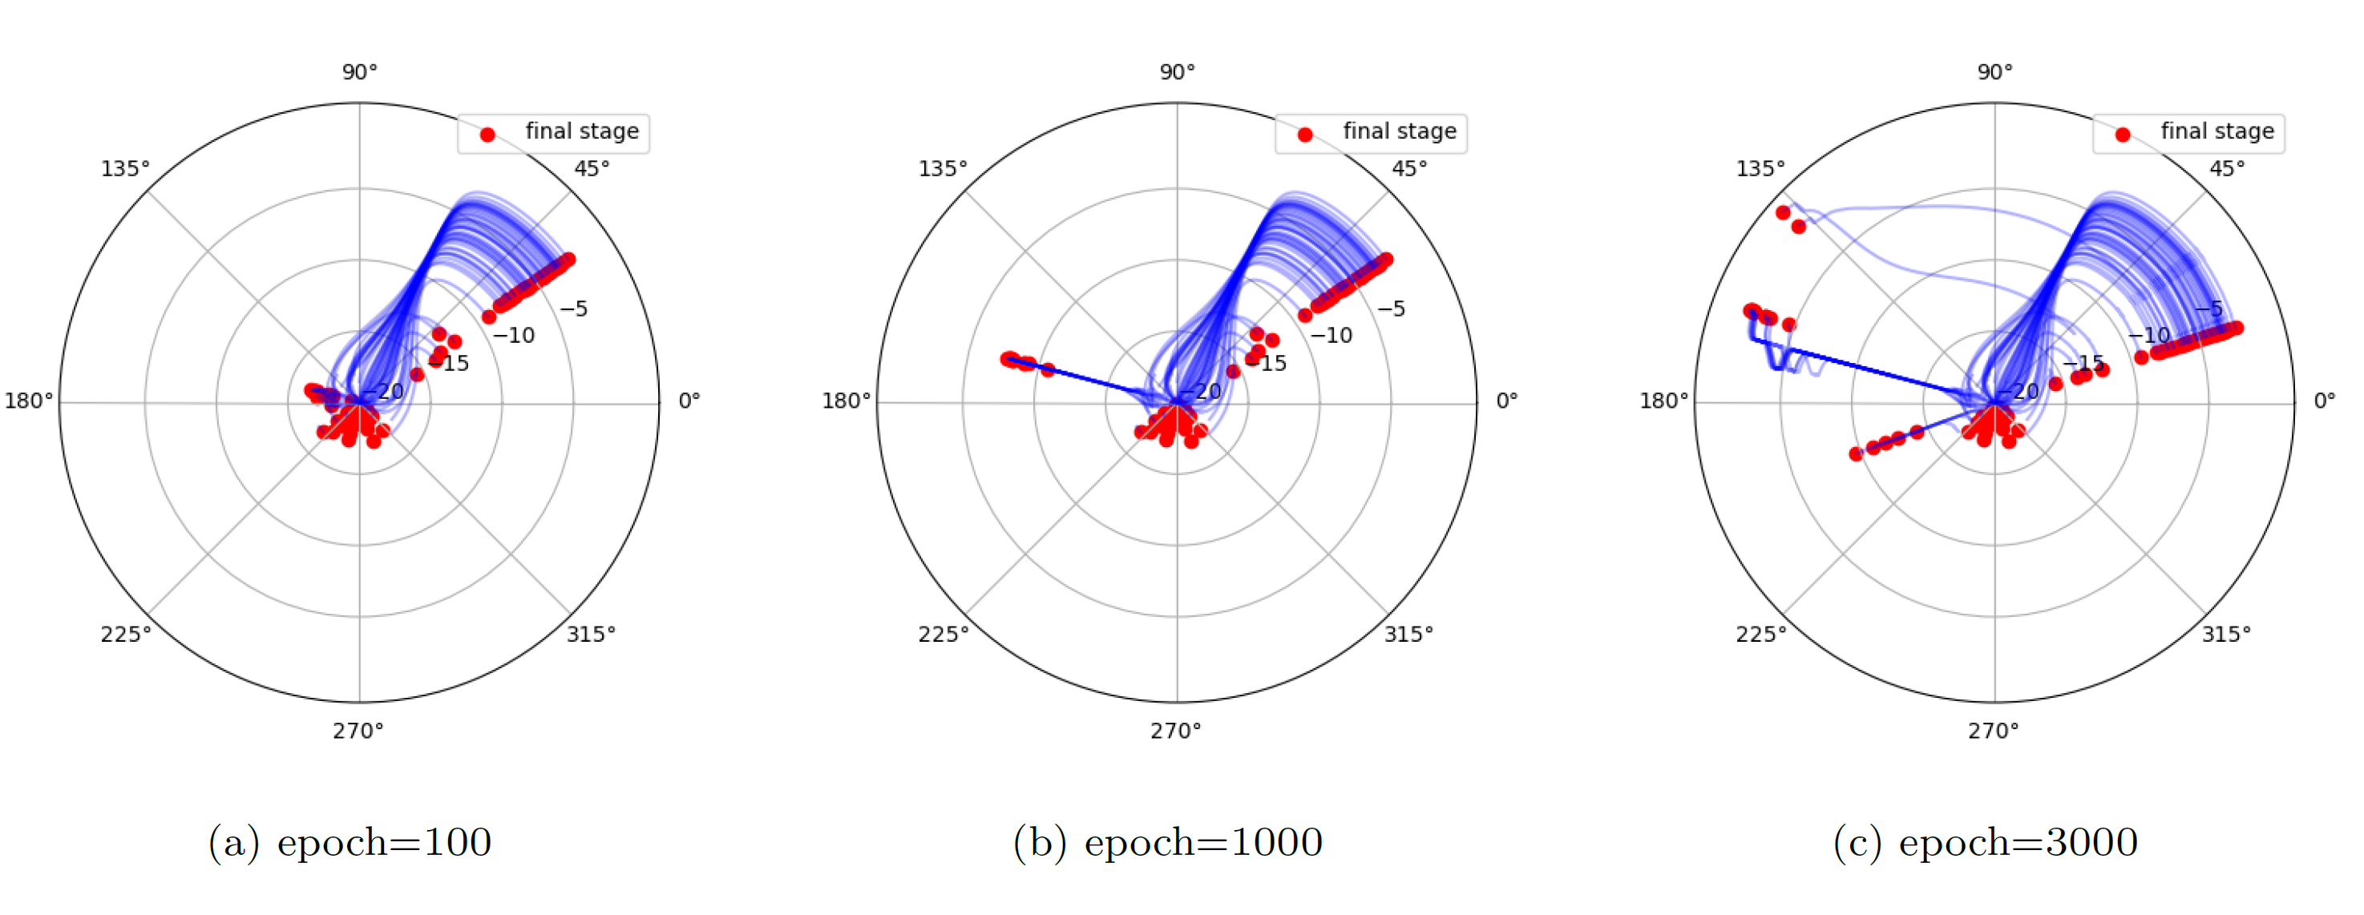



Evolution trajectory: change significantly
Each point: ($w_{j},b_{j}$)
$$b$$
$$w$$
Tao Luo#, Zhi-Qin John Xu #, Zheng Ma, Yaoyu Zhang*,
Phase diagram for two-layer ReLU neural networks at infinite-width limit, Journal of Machine Learning Research (2021)

Slide 45
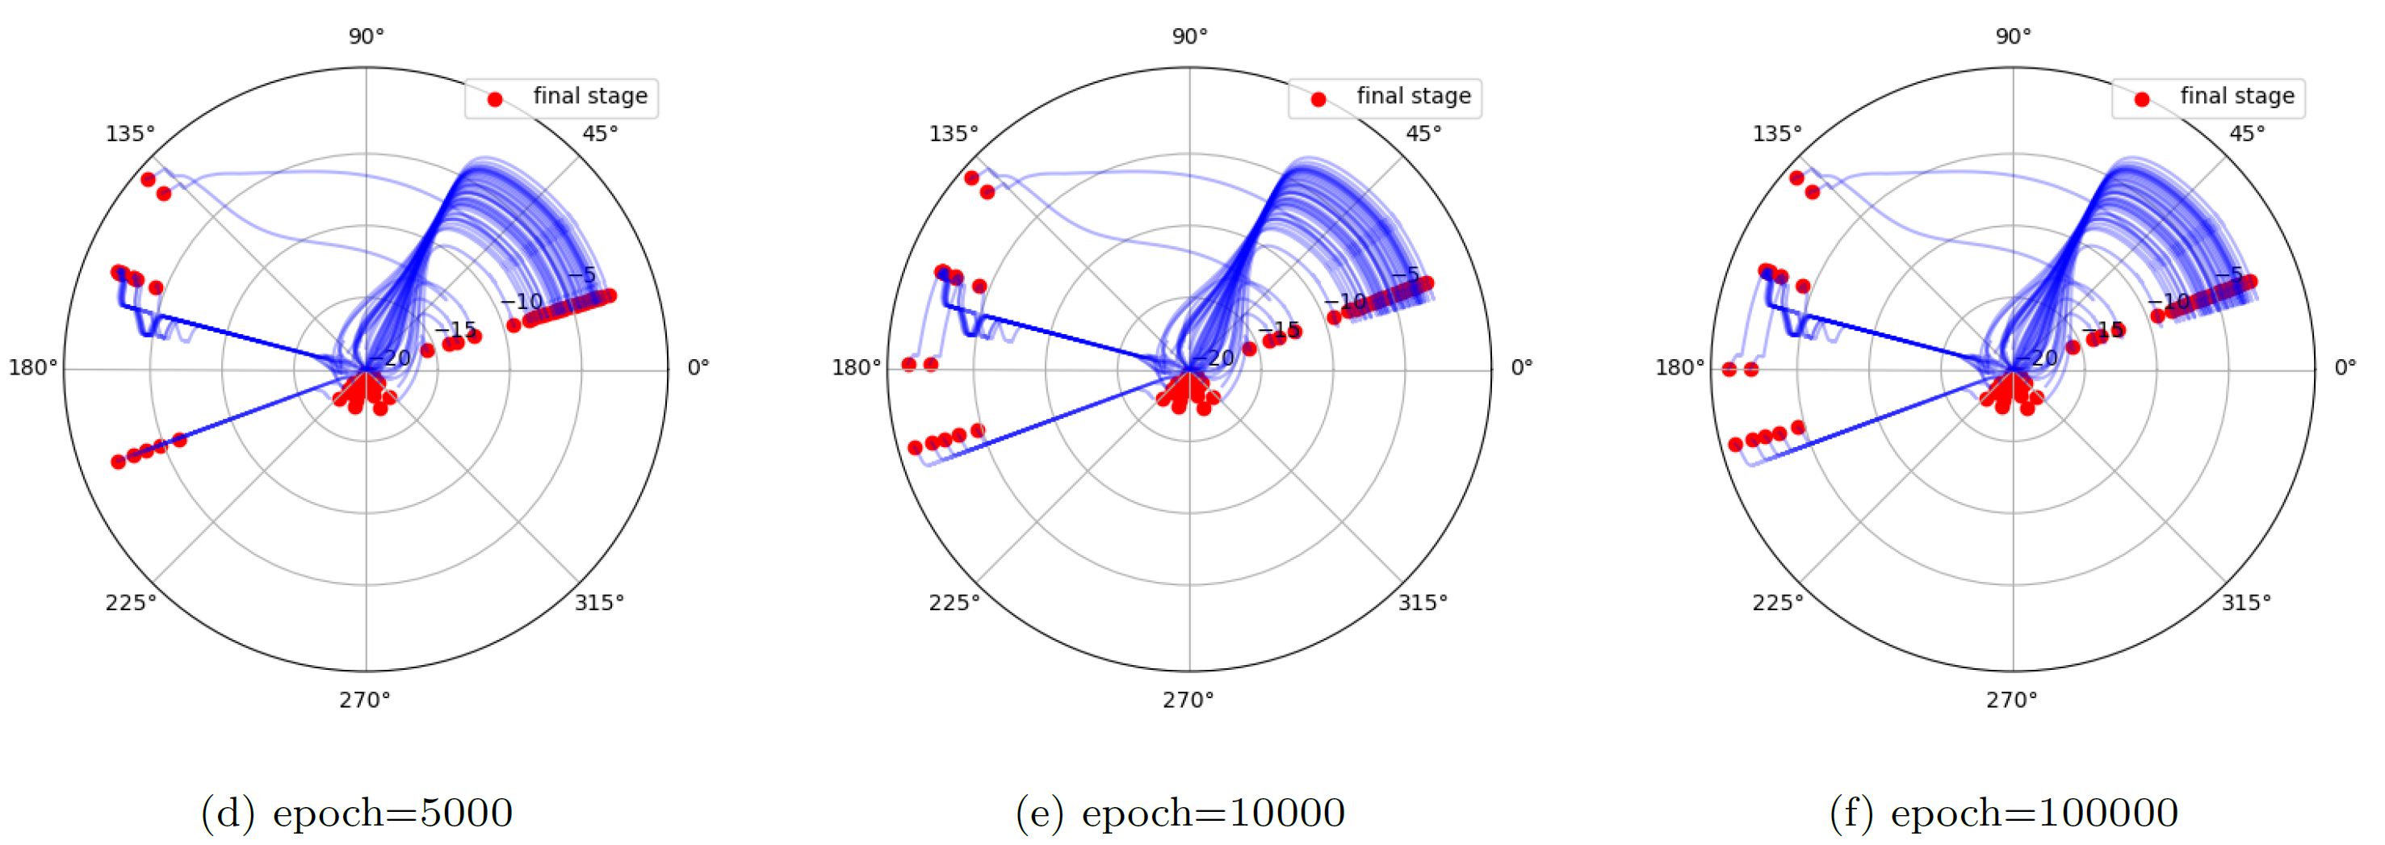
Evolution trajectory: change significantly
Each point: ($w_{j},b_{j}$)
$$b$$
$$w$$
Tao Luo#, Zhi-Qin John Xu #, Zheng Ma, Yaoyu Zhang*,
Phase diagram for two-layer ReLU neural networks at infinite-width limit, Journal of Machine Learning Research (2021)

Slide 46
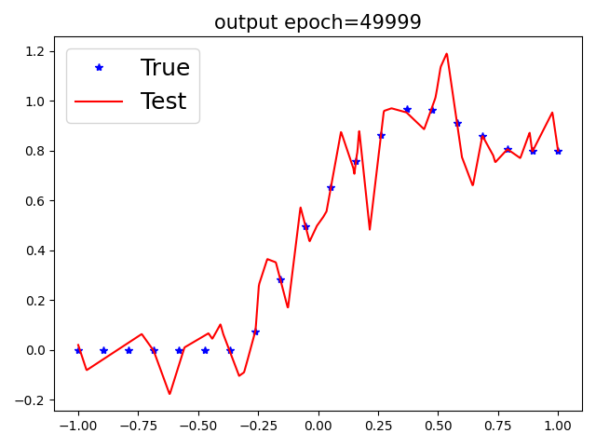
Small vs. large initialization
$$f_{θ}\left(x\right)=\sum_{j=1}^{m}{a_{j}σ{(w_{j}x+b_{j})}}$$
small initialization
large initialization
Tao Luo#, Zhi-Qin John Xu #, Zheng Ma, Yaoyu Zhang*,
Phase diagram for two-layer ReLU neural networks at infinite-width limit, Journal of Machine Learning Research (2021)

Slide 47
Condensation in Transformer!
Zhongwang Zhang, Pengxiao Lin, Zhiwei Wang, Yaoyu Zhang, Zhi-Qin John Xu*, Initialization is Critical to Whether Transformers Fit Composite Functions by Reasoning or Memorizing, NeurIPS 2024

Slide 48
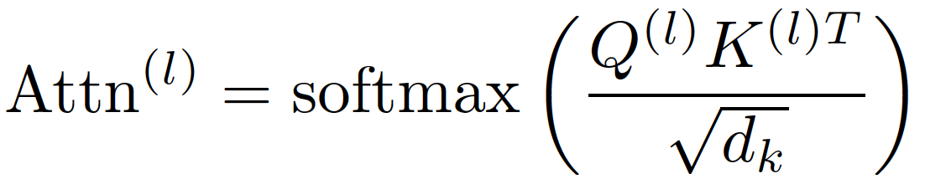
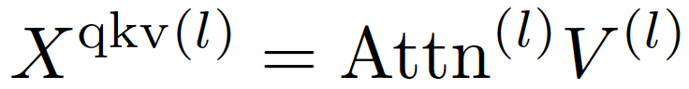
Transformer
Zhongwang Zhang, Pengxiao Lin, Zhiwei Wang, Yaoyu Zhang, Zhi-Qin John Xu*, Initialization is Critical to Whether Transformers Fit Composite Functions by Reasoning or Memorizing, NeurIPS 2024

Slide 49


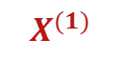
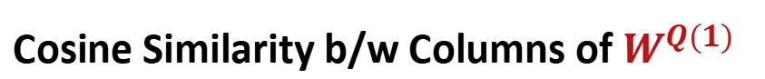
Condensation of $W^{Q(1)}$ by column
$$X^{(1)}$$
output: $Q^{(1)}$
$$W^{Q(1)}$$
Cosine Similarity b/w Columns of $W^{Q(1)}$
Each column is the weight of a neuron
If all columns are the same, what then?
one effective neuron!
Zhongwang Zhang, Pengxiao Lin, Zhiwei Wang, Yaoyu Zhang, Zhi-Qin John Xu*, Initialization is Critical to Whether Transformers Fit Composite Functions by Reasoning or Memorizing, NeurIPS 2024

Slide 50
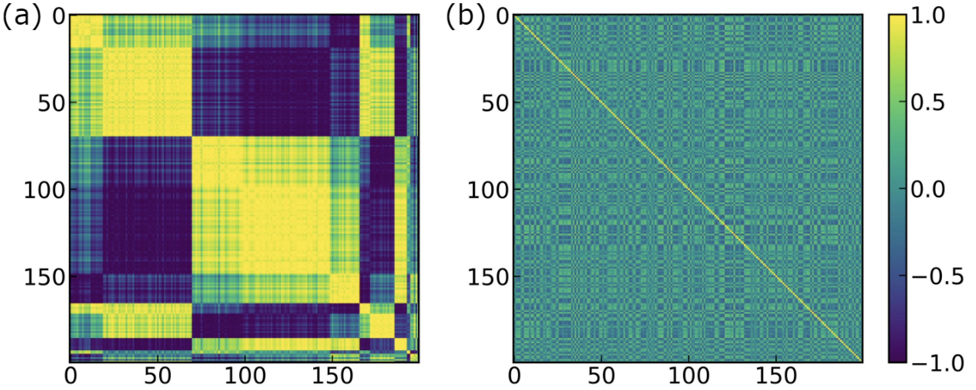
Condensation of $W^{Q(1)}$ by column
$$X^{(1)}$$
output: $Q^{(1)}$
$$W^{Q(1)}$$
Cosine Similarity b/w Columns of $W^{Q(1)}$
Each column is the weight of a neuron
Small ini: clear condensation
Large ini: no condensation
Zhongwang Zhang, Pengxiao Lin, Zhiwei Wang, Yaoyu Zhang, Zhi-Qin John Xu*, Initialization is Critical to Whether Transformers Fit Composite Functions by Reasoning or Memorizing, NeurIPS 2024

Slide 51
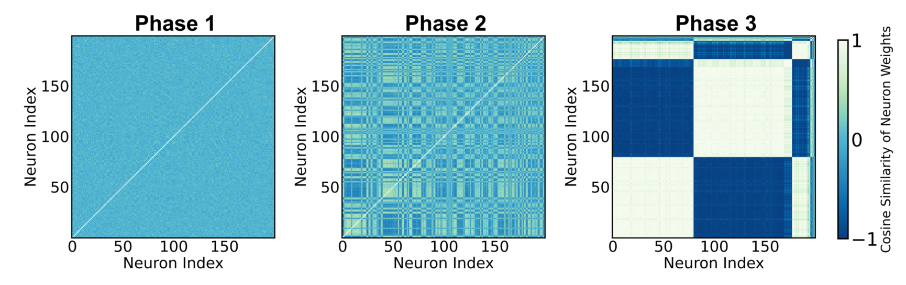
Condensation of $W^{Q(1)}$ by column
$$X^{(1)}$$
output: $Q^{(1)}$
$$W^{Q(1)}$$
Cosine Similarity b/w Columns of $W^{Q(1)}$
Each column is the weight of a neuron
Small ini: clear condensation
Large ini: no condensation
Zhongwang Zhang, Pengxiao Lin, Zhiwei Wang, Yaoyu Zhang, Zhi-Qin John Xu*, Initialization is Critical to Whether Transformers Fit Composite Functions by Reasoning or Memorizing, NeurIPS 2024

Slide 52
Zhongwang Zhang, Pengxiao Lin, Zhiwei Wang, Yaoyu Zhang, Zhi-Qin John Xu*, Initialization is Critical to Whether Transformers Fit Composite Functions by Reasoning or Memorizing, NeurIPS 2024

Slide 53
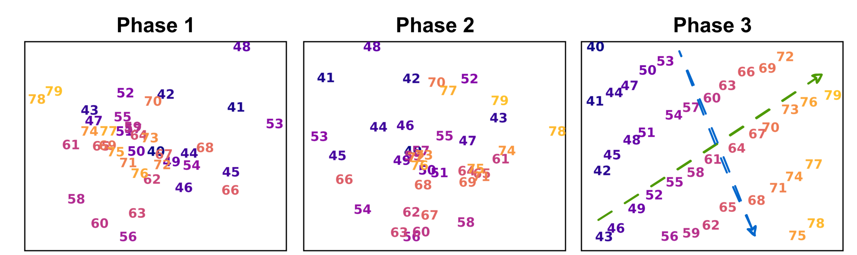
嵌入结构
Zhongwang Zhang, Pengxiao Lin, Zhiwei Wang, Yaoyu Zhang, Zhi-Qin John Xu*, Initialization is Critical to Whether Transformers Fit Composite Functions by Reasoning or Memorizing, NeurIPS 2024

Slide 54
Mechanisms underlying initialization effect
Low complexity as possible
Only learn
four anchor
Generalize
on inference
Small initial
Condense
Vey slight
condense
Large
complexity
Easily fit ten
sym. maps
Generalize
on sym. map
Large initial
Very
Large initial
No
condense
Very large
complexity
Easily all
fit maps
No Generalize
Zhongwang Zhang, Pengxiao Lin, Zhiwei Wang, Yaoyu Zhang, Zhi-Qin John Xu*, Initialization is Critical to Whether Transformers Fit Composite Functions by Reasoning or Memorizing, NeurIPS 2024

Slide 55
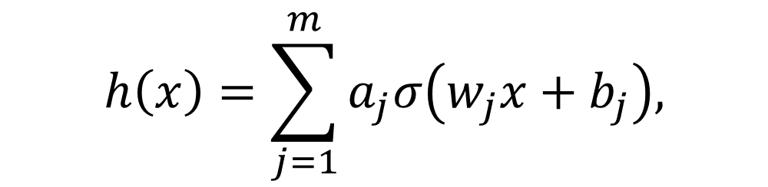
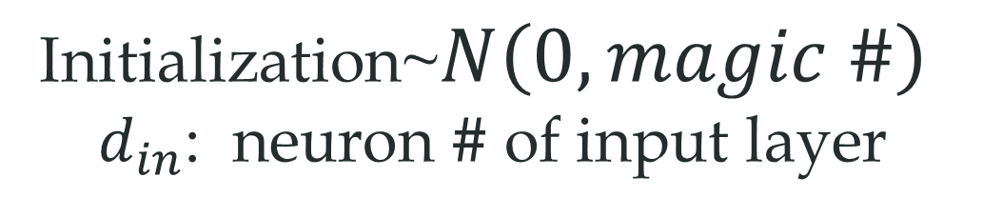
How small? How large?
$$h\left(x\right)=\sum_{j=1}^{m}{a_{j}σ\left(w_{j}x+b_{j}\right),}$$
Deep Net
Initialization~$N\left(0,magic \#\right)$
$d_{in}$: neuron # of input layer

Slide 56
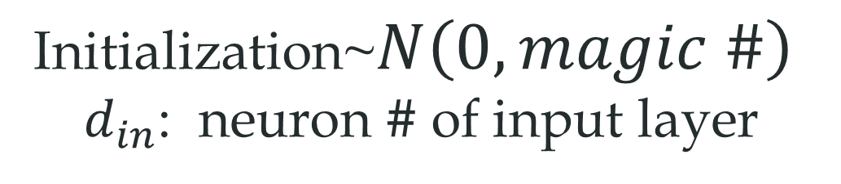
How small? How large?
$$h\left(x\right)=\sum_{j=1}^{m}{a_{j}σ\left(w_{j}x+b_{j}\right),}$$
Smaller
Initialization~$N\left(0,magic \#\right)$
$d_{in}$: neuron # of input layer

Slide 57
How small? How large?
$$h\left(x\right)=\sum_{j=1}^{m}{a_{j}σ\left(w_{j}x+b_{j}\right),}$$
Larger
Initialization~$N\left(0,magic \#\right)$
$d_{in}$: neuron # of input layer

Slide 58
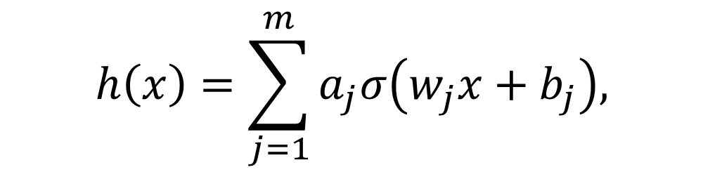

Parameter initialization
$$h\left(x\right)=\sum_{j=1}^{m}{a_{j}σ\left(w_{j}x+b_{j}\right),}$$
Initialization~$N\left(0,{\left(\frac{1}{d_{in}^{γ}}\right)}^{2}\right)$
$d_{in}$: neuron # of input layer
Luo#, Xu#, Ma, Zhang*, 2007.07497, JMLR; Zhou, Zhou, Jin Luo, Zhang*, Xu*, NeurIPS 2022

Slide 59


Parameter initialization
$$h\left(x\right)=\sum_{j=1}^{m}{a_{j}σ\left(w_{j}x+b_{j}\right),}$$
Initialization~$N\left(0,{\left(\frac{1}{d_{in}^{γ}}\right)}^{2}\right)$
$d_{in}$: neuron # of input layer
Thm: For different network sizes,
$γ$ stays the same
→
similar behavior
Luo#, Xu#, Ma, Zhang*, 2007.07497, JMLR; Zhou, Zhou, Jin Luo, Zhang*, Xu*, NeurIPS 2022

Slide 60
Complexity restriction is the key!

Slide 61

Effect of weight decay and lr
Large wd + large lr (within a certain range)
Condense
Inferential solution
Zhongwang Zhang, Pengxiao Lin, Zhiwei Wang, Yaoyu Zhang, Zhi-Qin John Xu*, Initialization is Critical to Whether Transformers Fit Composite Functions by Reasoning or Memorizing, NeurIPS 2024

Slide 62
Verification in more experiments!

Slide 63


Diffusion model
failure mode
010
011
Okawa 2024, NeurIPS 2024
Zhongwang Zhang, Pengxiao Lin, Zhiwei Wang, Yaoyu Zhang, Zhi-Qin John Xu*, Complexity Control Facilitates Reasoning-Based Compositional Generalization in Transformers, arxiv 2501.08537

Slide 64
Diffusion model
Zhongwang Zhang, Pengxiao Lin, Zhiwei Wang, Yaoyu Zhang, Zhi-Qin John Xu*, Complexity Control Facilitates Reasoning-Based Compositional Generalization in Transformers, arxiv 2501.08537

Slide 65

语言任务逐渐显示推理
$$γ=0.1$$
187M 模型
40B数据
Weight Decay=0
Initialization scale
红色：预测概率低
绿色：预测概率高
未见过的法律文本
大部分预测不对
Arxiv:2505.23013

Slide 66


语言任务逐渐显示推理
$$γ=0.5$$
187M 模型
40B数据
Weight Decay=0
Initialization scale
红色：预测概率低
绿色：预测概率高
未见过的法律文本
语法和见过预测准
Arxiv:2505.23013

Slide 67


语言任务逐渐显示推理
$$γ=1$$
187M 模型
40B数据
Weight Decay=0
Initialization scale
红色：预测概率低
绿色：预测概率高
未见过的法律文本
情景推理预测准
Arxiv:2505.23013

Slide 68
偏推理数据提升明显
应用在盘古135B大模型，$γ\sim 1$
Arxiv:2505.23013

Slide 69


Scaling law in data, 0.8B Model
Initialization~$N\left(0,{\left(\frac{1}{d_{in}^{γ}}\right)}^{2}\right)$
$d_{in}$: neuron # of input layer
调节标准差: 大数据，增益缓
调节$γ$: 稳定降低测试误差
调节标准差: 不同宽度的部分用同一个标准差
Arxiv:2505.23013

Slide 70
Scaling law in data, 0.8B Model
Initialization~$N\left(0,{\left(\frac{1}{d_{in}^{γ}}\right)}^{2}\right)$
$d_{in}$: neuron # of input layer
调节标准差: 大模型，增益缓
调节$γ$: 稳定降低测试误差
调节标准差: 不同宽度的部分用同一个标准差
Arxiv:2505.23013

Slide 71

Addition task
Addition: $a+b=c, a, b∈ [0, 999]$. Test on $a, b∈ [400, 600]$, train on the other data.
Zhongwang Zhang, Pengxiao Lin, Zhiwei Wang, Yaoyu Zhang, Zhi-Qin John Xu*, Initialization is Critical to Whether Transformers Fit Composite Functions by Inference or Memorizing, NeurIPS 2024

Slide 72

Other realistic compositional dataset
SCAN IN: turn right after jump twice OUT: I_JUMP I_JUMP I_TURN_RIGHT
COGS IN: A cake rolled . OUT: cake ( x _ 1 ) AND roll . theme ( x _ 2 , x _ 1 )
I.D: Generalization of different combinations of primitives
O.O.D: Generalization of specific primitives to unseen sentence patterns
Zhongwang Zhang, Pengxiao Lin, Zhiwei Wang, Yaoyu Zhang, Zhi-Qin John Xu*, Initialization is Critical to Whether Transformers Fit Composite Functions by Inference or Memorizing, NeurIPS 2024

Slide 73

SlimPajama
Different initialization
GPT-2 Medium + 33B GitHub section (&22B Wikipedia section) of SlimPajama
Zhongwang Zhang, Pengxiao Lin, Zhiwei Wang, Yaoyu Zhang, Zhi-Qin John Xu*, Initialization is Critical to Whether Transformers Fit Composite Functions by Inference or Memorizing, NeurIPS 2024

Slide 74

Other realistic reasoning dataset
More data, more steps to memorize
Zhongwang Zhang, Pengxiao Lin, Zhiwei Wang, Yaoyu Zhang, Zhi-Qin John Xu*, Complexity Control Facilitates Reasoning-Based Compositional Generalization in Transformers, arxiv 2501.08537

Slide 75
预测新的实验

Slide 76

Prediction
inferential complexity (IC): #(non-inferential group) keeping symmetry
EX:
$f\left(x;1,1\right)=x+10$, $f\left(x;1,2\right)=f\left(x;2,1\right)=x+6$, $f\left(x;1,3\right)=f\left(x;3,1\right)=x+3$, $f\left(x;1,4\right)=f\left(x;4,1\right)=x−3$
$f\left(x;2,2\right)=x+2$, $f\left(x;2,3\right)=f\left(x;3,2\right)=x−1$, $f\left(x;2,4\right)=f\left(x;4,2\right)=x−7$
$f\left(x;3,3\right)=x−4$, $f\left(x;3,4\right)=f\left(x;4,3\right)=x−10$
$f\left(x;4,4\right)=f\left(x;4,4\right)=x−16$
Zhongwang Zhang, Pengxiao Lin, Zhiwei Wang, Yaoyu Zhang, Zhi-Qin John Xu*, Initialization is Critical to Whether Transformers Fit Composite Functions by Inference or Memorizing, NeurIPS 2024

Slide 77

Prediction：
Reasoning complexity (RC): #(non-Rnferential group) keeping symmetry
EX:
$f\left(x;1,1\right)=x+5$, $f\left(x;1,2\right)=f\left(x;2,1\right)=x−5$, $f\left(x;1,3\right)=f\left(x;3,1\right)=x+3$, $f\left(x;1,4\right)=f\left(x;4,1\right)=x−3$
$f\left(x;2,2\right)=x+2$, $f\left(x;2,3\right)=f\left(x;3,2\right)=x+2$, $f\left(x;2,4\right)=f\left(x;4,2\right)=x−7$
$f\left(x;3,3\right)=x−4$, $f\left(x;3,4\right)=f\left(x;4,3\right)=x−10$
$f\left(x;4,4\right)=f\left(x;4,4\right)=x−16$
IC=3
Low complexity as possible
Larger RC
More steps
Small initial
Condense
Vey slight
condense
Large
complexity
ten sym. maps
for any RC
Similar steps for any RC
Large initial
Zhongwang Zhang, Pengxiao Lin, Zhiwei Wang, Yaoyu Zhang, Zhi-Qin John Xu*, Initialization is Critical to Whether Transformers Fit Composite Functions by Inference or Memorizing, NeurIPS 2024

Slide 78

Prediction verified!
Low complexity as possible
Larger RC
More steps
Small initial
Condense
Vey slight
condense
Large
complexity
ten sym. maps
for any RC
Similar steps for any RC
Large initial
Zhongwang Zhang, Pengxiao Lin, Zhiwei Wang, Yaoyu Zhang, Zhi-Qin John Xu*, Initialization is Critical to Whether Transformers Fit Composite Functions by Inference or Memorizing, NeurIPS 2024

Slide 79

推理复杂度为1的情况
将锚对 (a, b) 和 (b, a) 设置为违反组合规则的相同映射

